Slide 1
Assignment 5
Generative Modeling

Slide 2
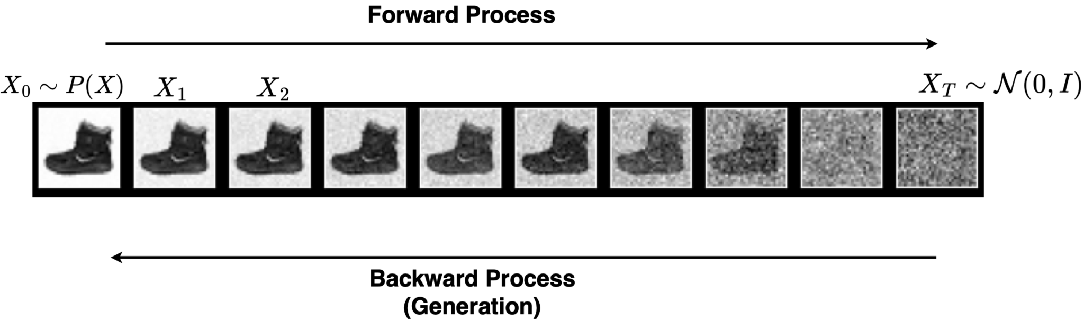
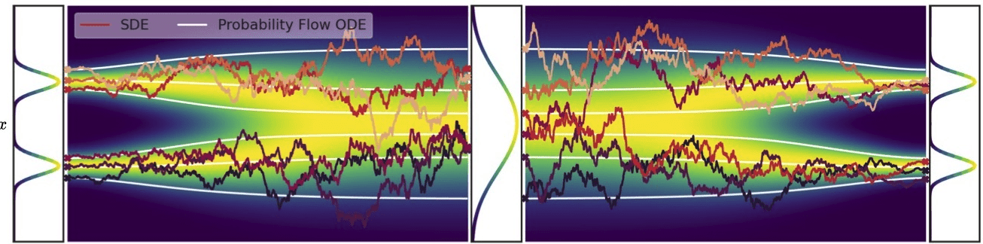
Denoising Diffusion Probabilistic Models (DDPM)

Slide 3
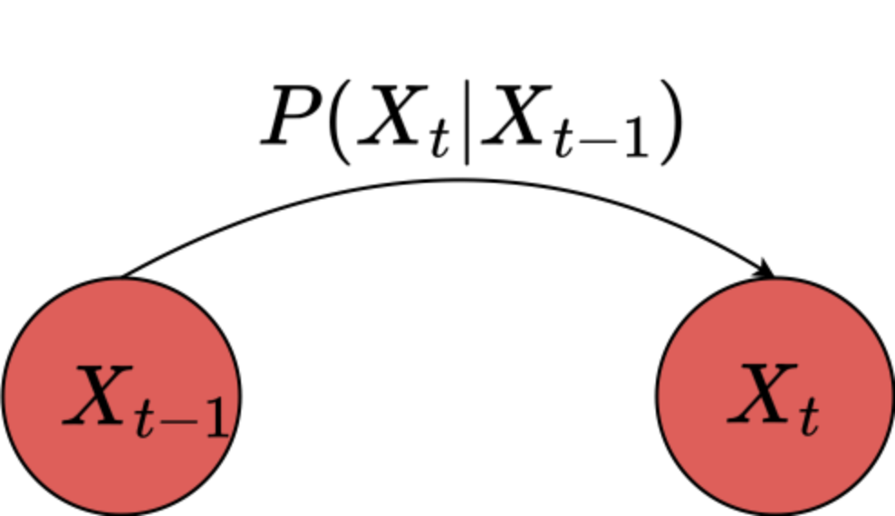
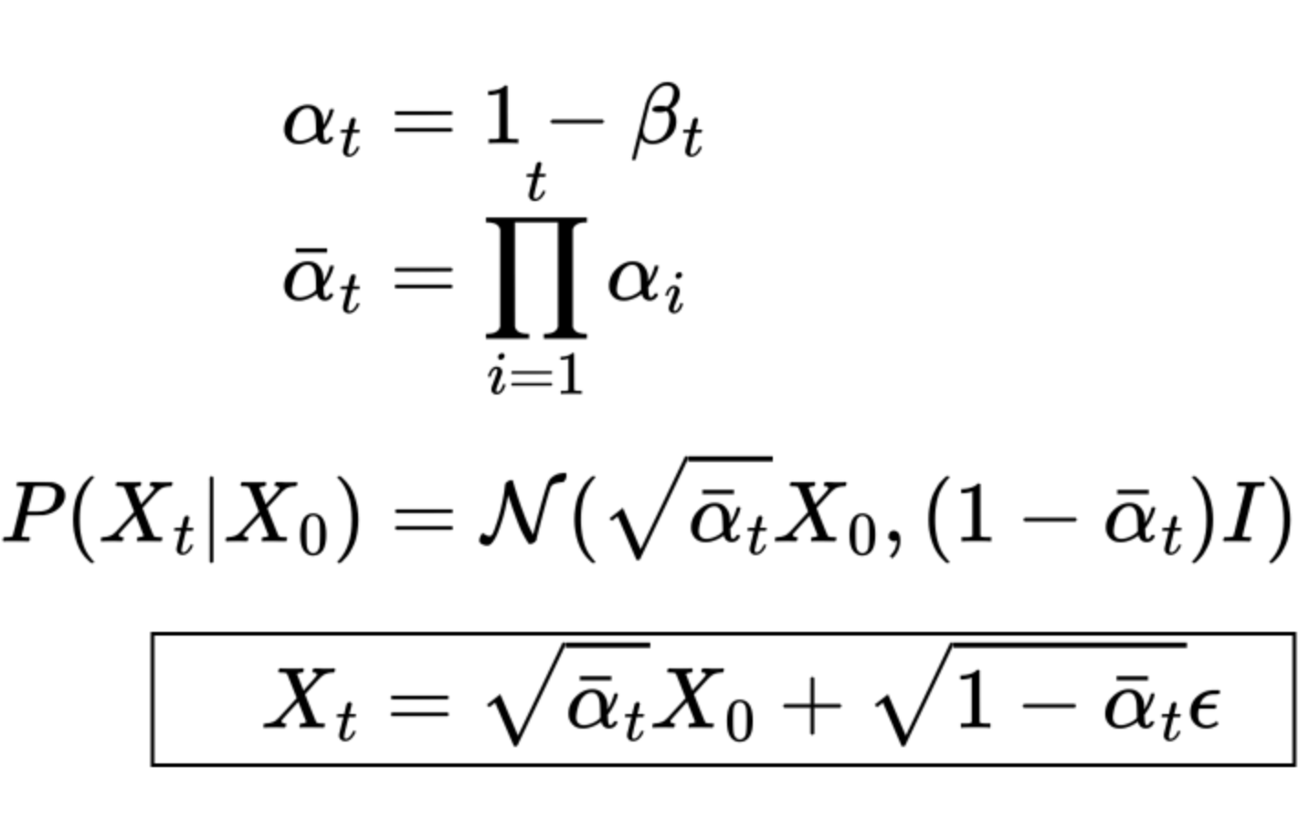
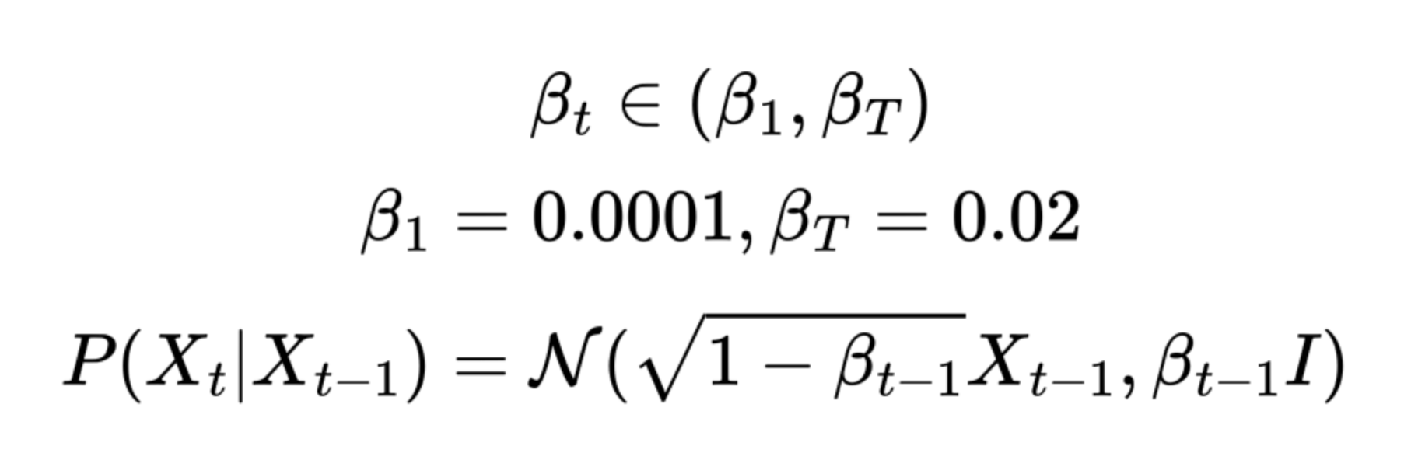
DDPM Forward Process

Slide 4
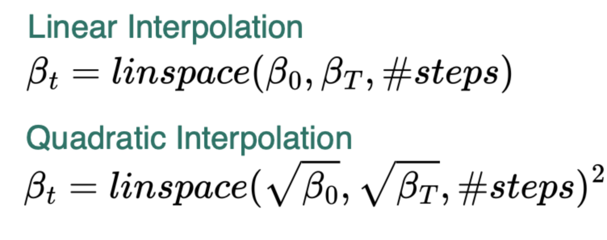
DDPM Forward Process

Slide 5
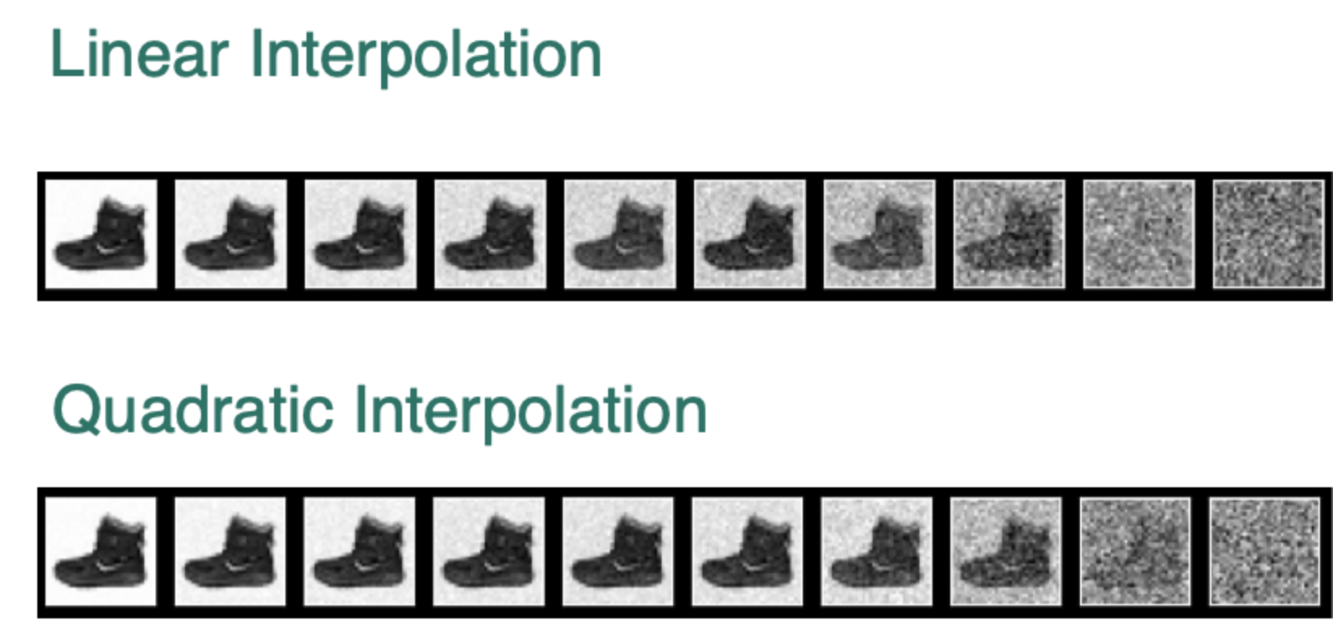
DDPM Forward Process

Slide 6
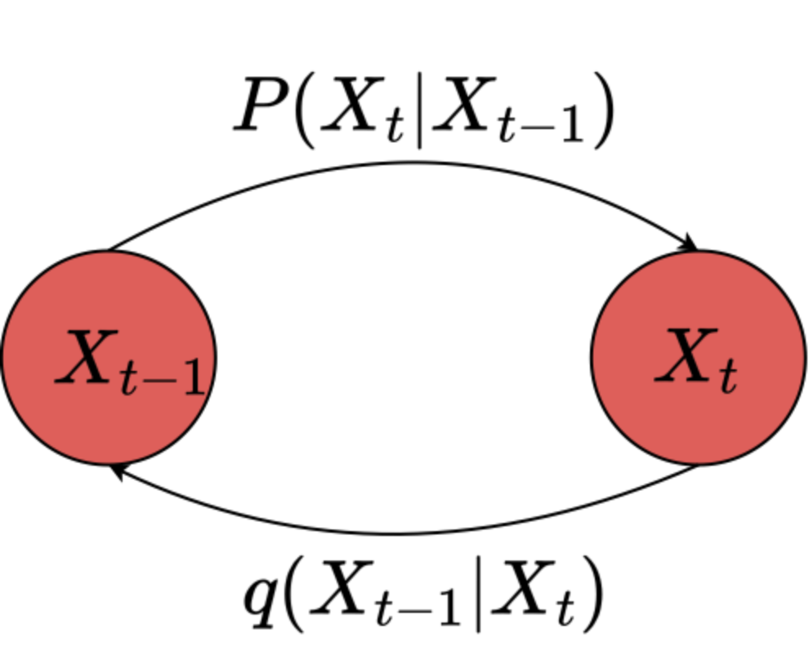
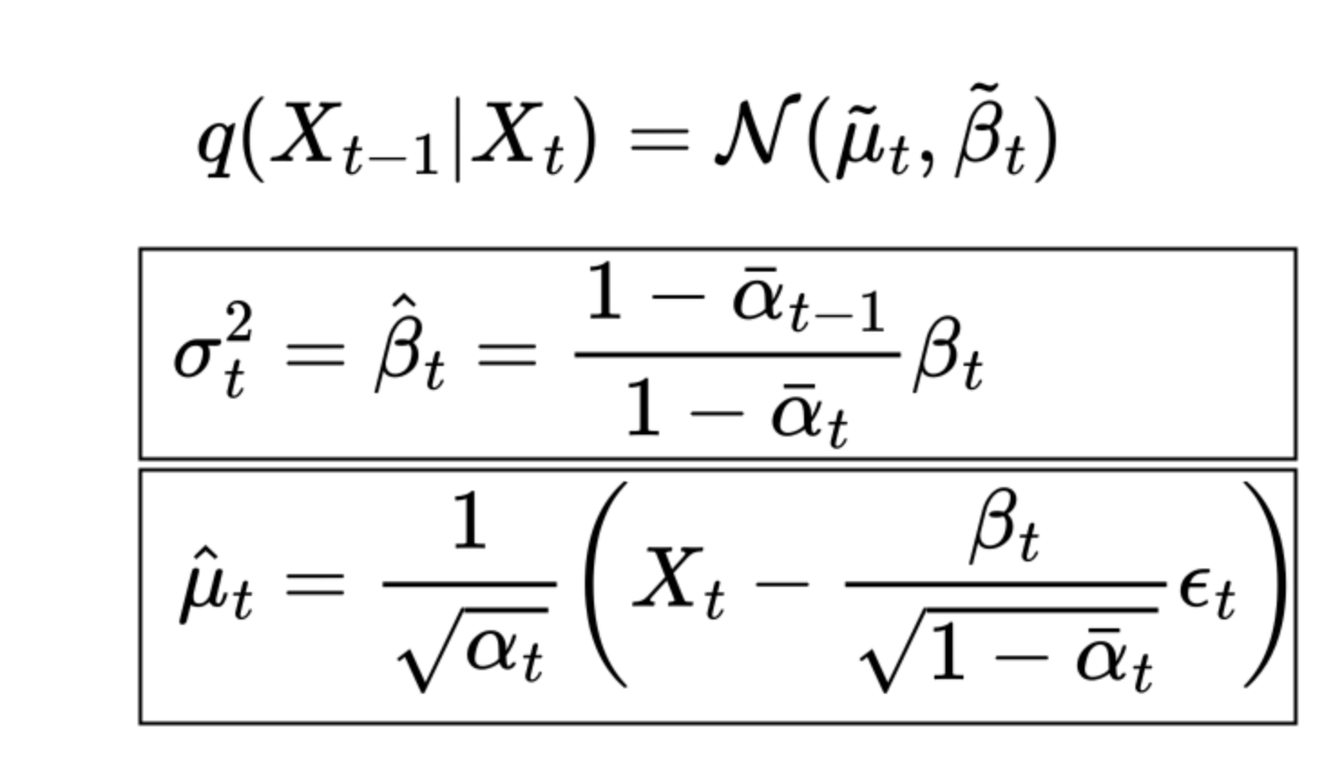
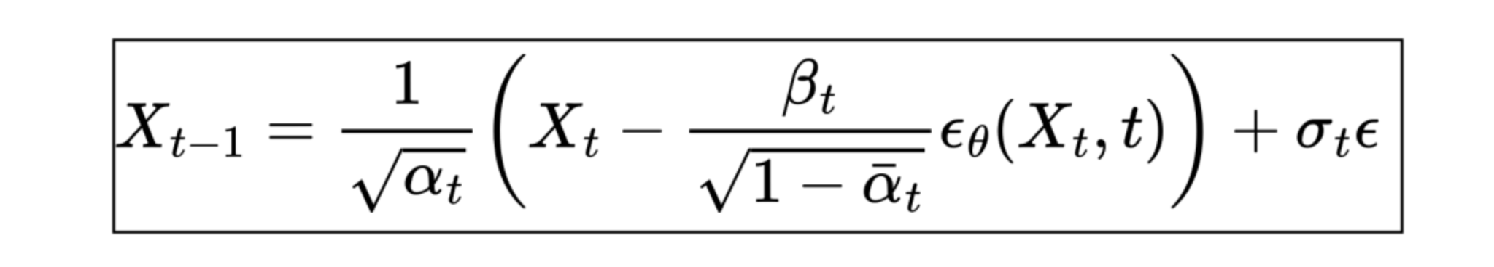
DDPM Backward Process

Slide 7
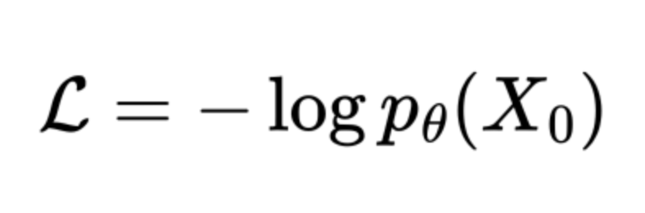
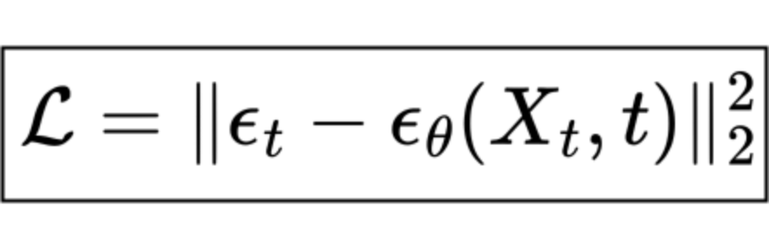
DDPM Loss Function
DDPM is trained to maximize the log-likelihood of observing the data:
But it can be shown that the above loss function can be achieved through the following loss function:

Slide 8
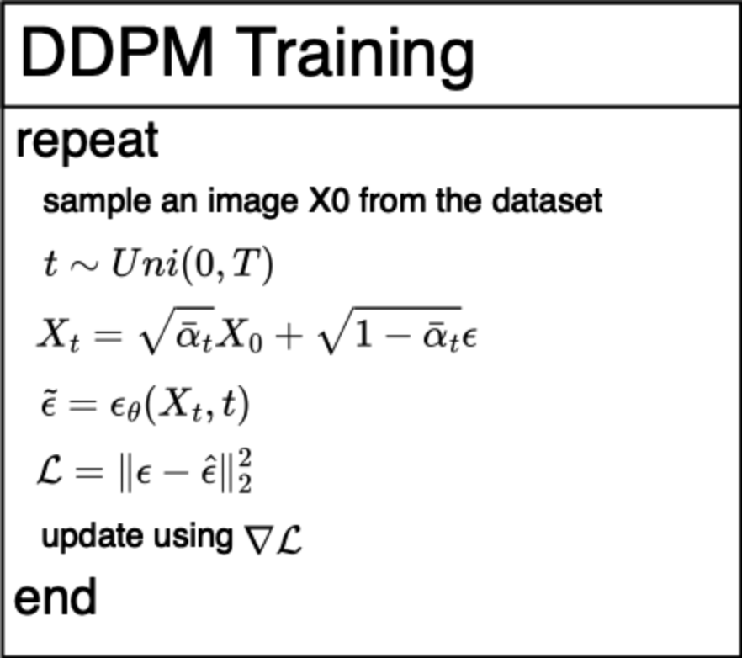
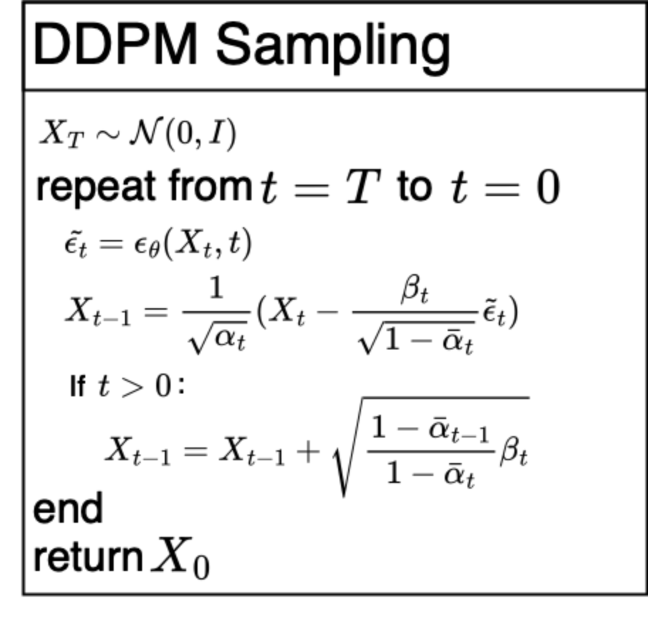
DDPM Training and Sampling

Slide 9
DDPM Implementation
The noise injection and handling statistical information is usually done inside a Variance Scheduler.
The network for estimating the level of noise is usually a UNet with time-embedding.

Slide 10
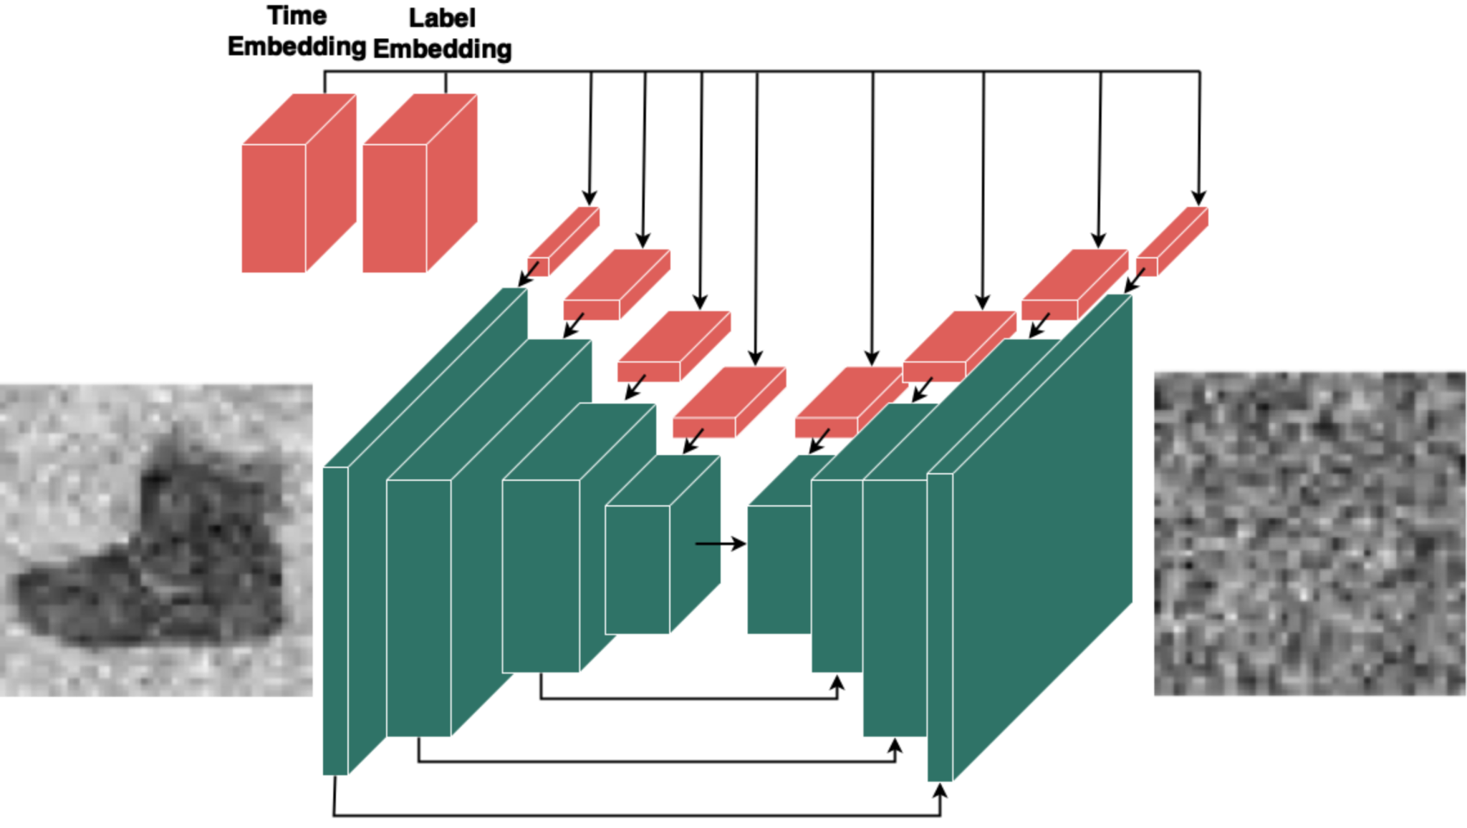
DDPM Implementation

Slide 11
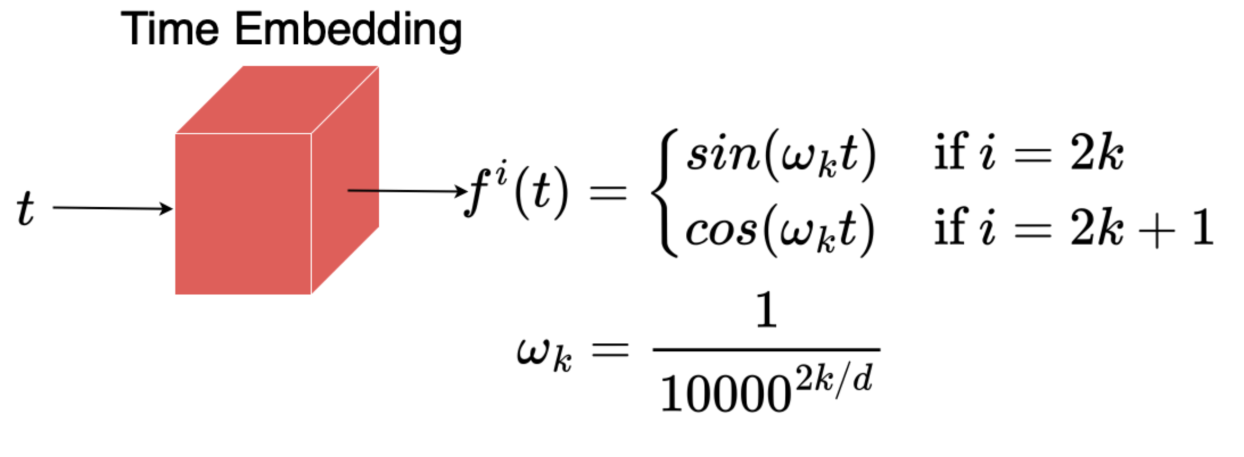
DDPM Implementation

Slide 12
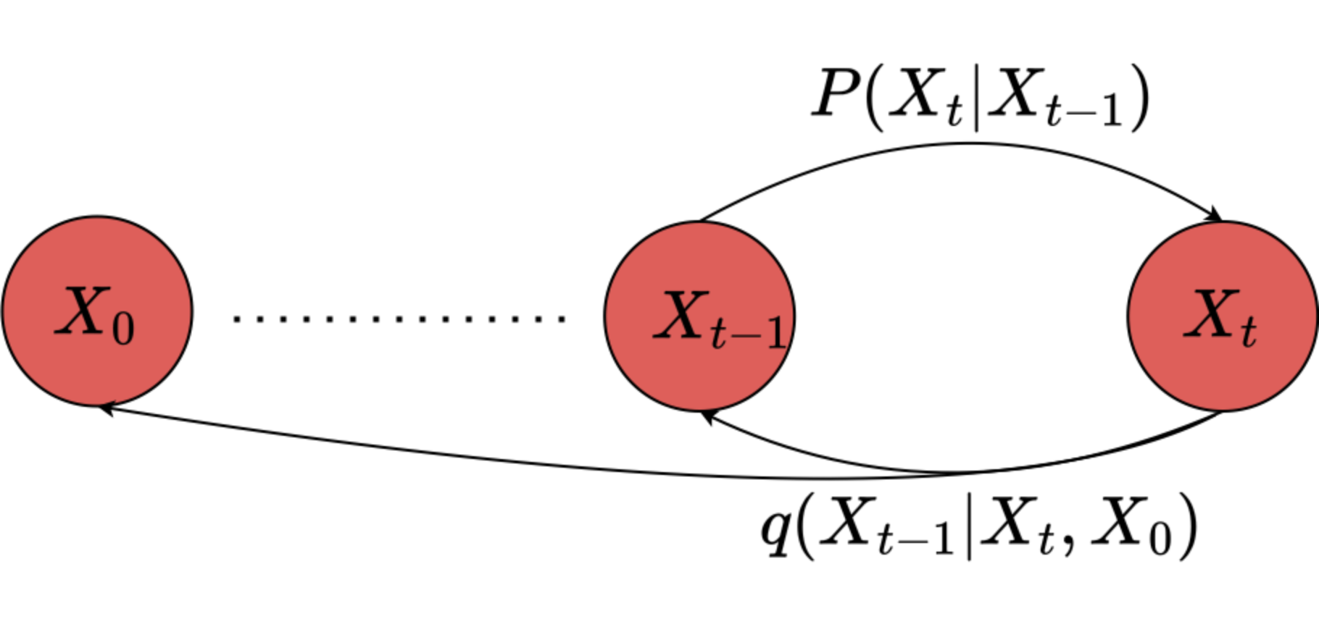
Denoising Diffusion Implicit Models (DDIM)
Very similar to DDPM, but markov chain property is broken, and sampling strategy is different.
Advantage: Works with a small subset of the timesteps (accelerated generation).

Slide 13
DDIM Forward Process
Exactly the same as that of DDPM

Slide 14
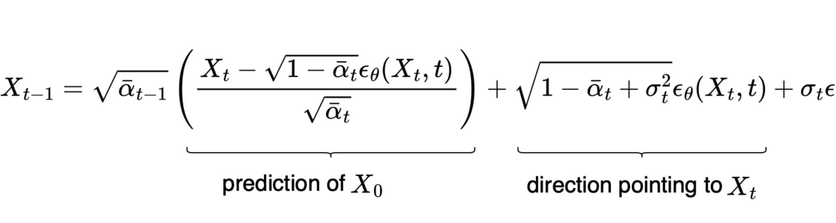
DDIM Backward Process
Different than DDPM

Slide 15
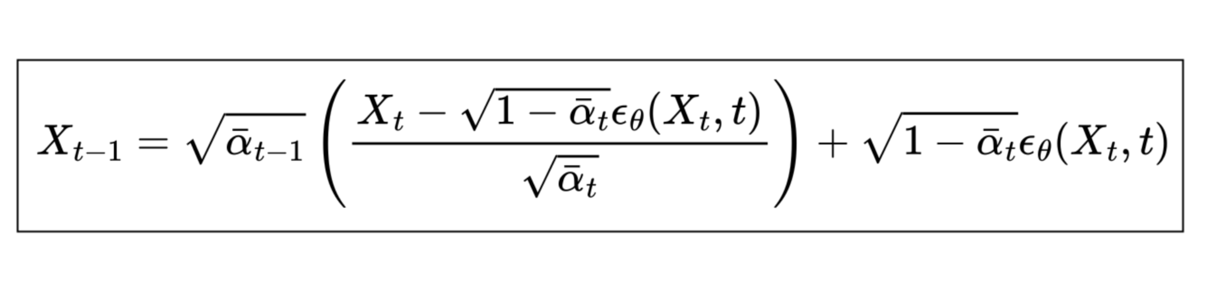
DDIM Backward Process
For a special case of variance DDIM becomes the same as DDPM (therefore it generalizes DDPM).
DDIM is especially useful when variance is zero (deterministic paths):
DDIM also uses the same loss function as DDPM.

Slide 16
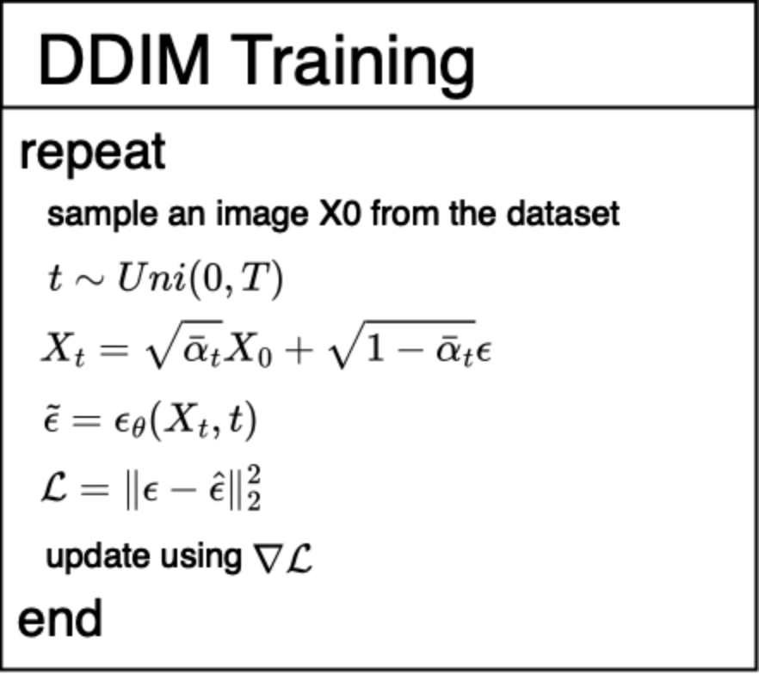
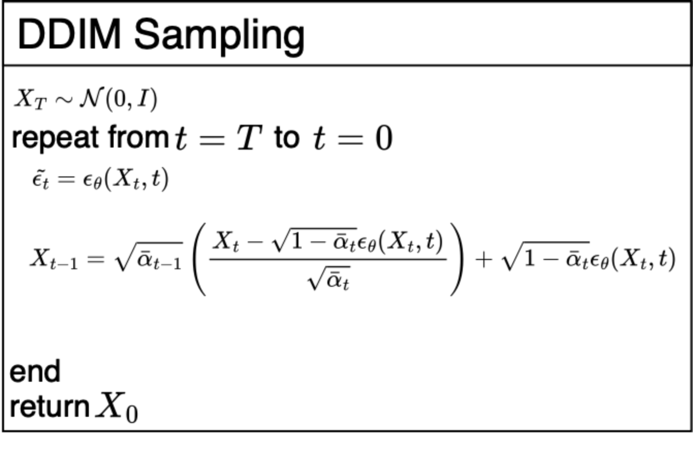
DDIM Training and Sampling

Slide 17
Variational Auto-Encoders (VAE)
VAEs find a mapping between the data distribution and a Normal distribution in a latent space.
Using a VAE, a sample image from the data distribution is encoded to sample from the Normal distribution, and then decoded back to the same sample in the data distribution.
Once a VAE is trained, the generation process is to simply take a random sample from the Normal distribution, and decode it into an actual image.

Slide 18
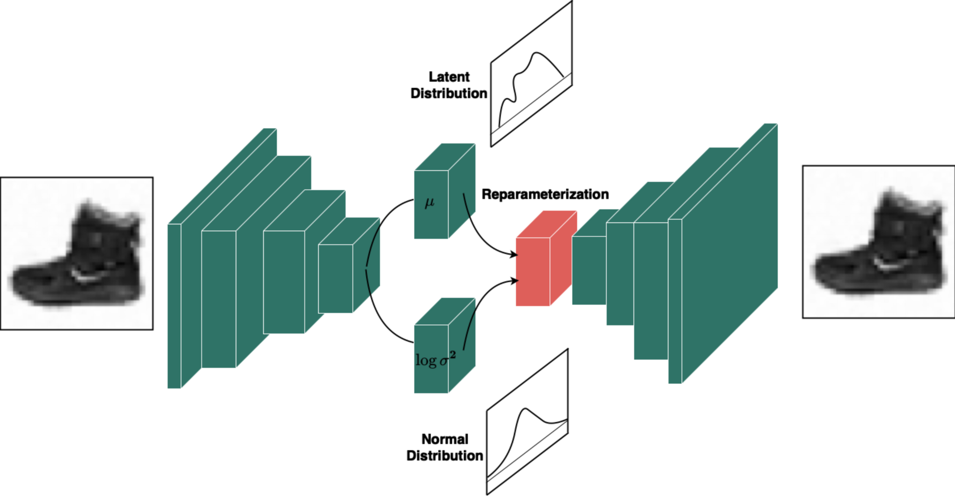
VAE Architecture

Slide 19
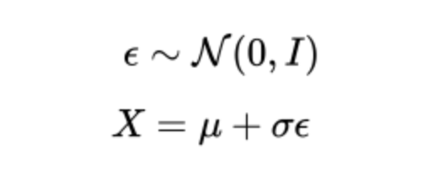
Reparameterization Trick
Sampling in general is not differentiable.
Reparameterization trick allows us to sample from the latent distribution while keeping it differentiable.
Instead of directly sampling from the latent, we sample from a Normal distribution, and scale it to the latent distribution:

Slide 20
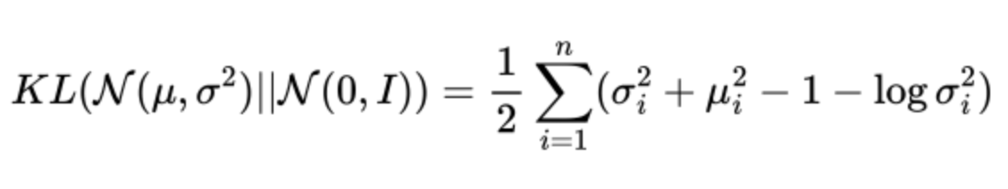
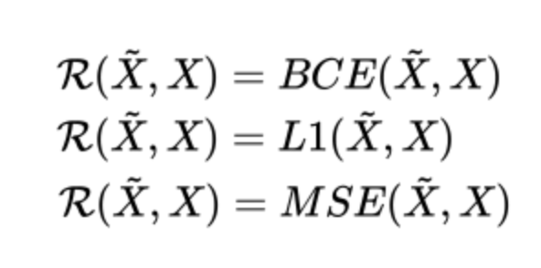
VAE Loss Function
Two things must be handled:
KL divergence of the latent distribution and the Normal distribution (KL loss):
Similarity of the output image and the input image (reconstruction loss):

Slide 21
VAE Sampling
Example: If the input image is 128x128, and we have 4 downsampling layers, and the latent dimension of the VAE is 32, then the size of samples at the latent space will be 32x8x8.
To generate images, we need to sample from the Normal distribution with the size 32x8x8 and decode the noises with the VAE decoder.

Slide 22
Latent Diffusion Models (LDDPM)
Usually used for handling large images (e.g. 512x512, 1024x1024 or larger).
It is hard to train diffusion models on such large images.
Also, the latent distribution of the VAE could be off from the normal distribution, hence the generation phase might not be as good as expected.
Idea: Use VAE to reduce the size of images and learn a latent distribution, and then use a DDPM in the latent of the VAE to better learn the correct distribution.
In this way, we are using the power of both models.
Such architectures are used in state of the art models such as Stable Diffusion.

Slide 23
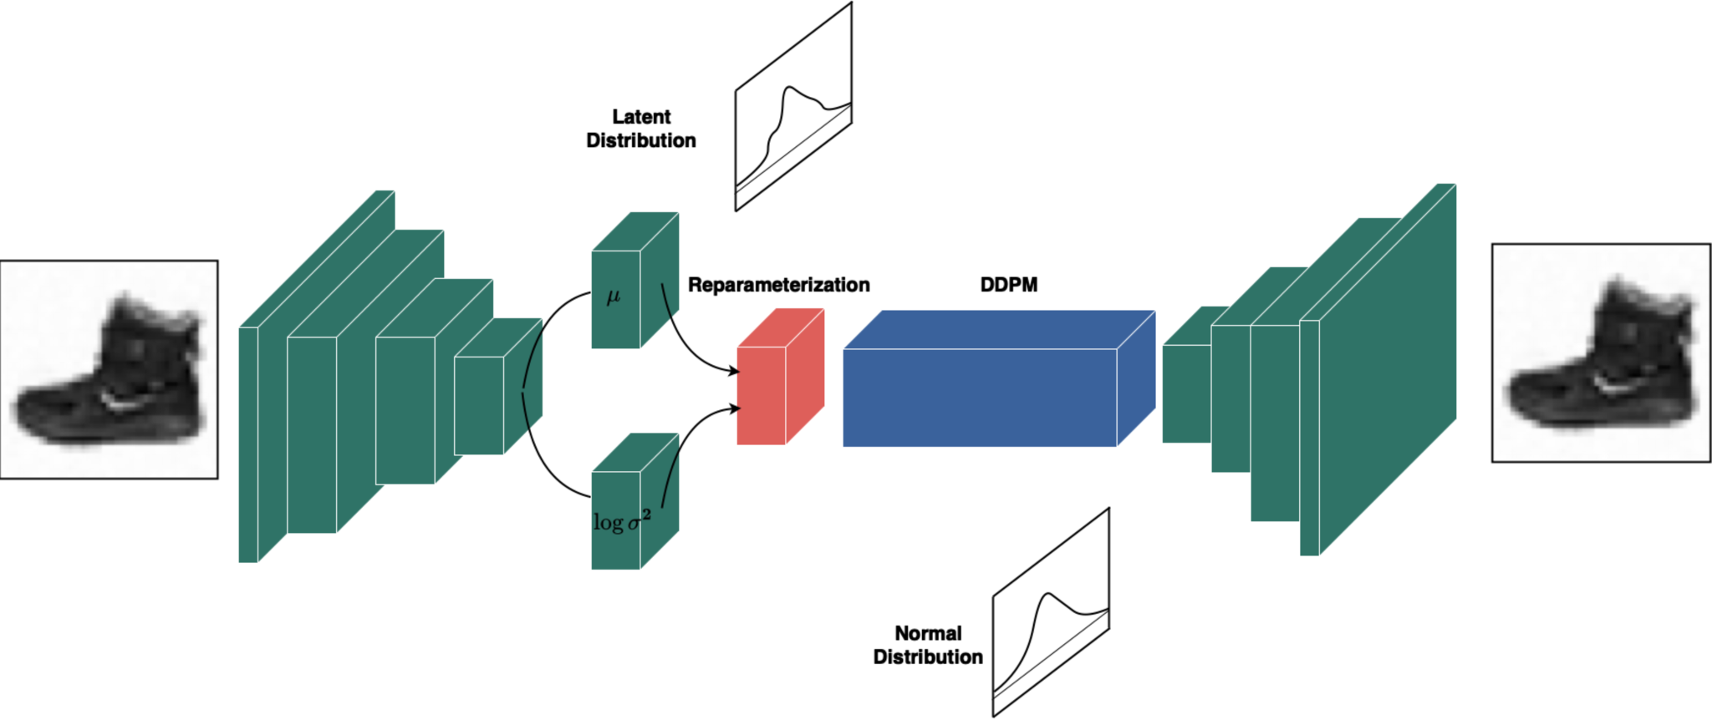
LDDPM Architecture

Slide 24
LDDPM Training and Sampling
Training LDDP comprises of two parts:
Training VAE (without the DDPM in the bottleneck)
Fixing the VAE, adding the DDPM at the bottleneck, training the whole network given that the parameters of the VAE are fixed.
Once the training is finished, to sample from LDDPM, we first take a sample from Normal distribution, then we find the sample in the VAE latent space using DDPM, and finally, we decode the recovered sample.
Example: If the size of samples in the latent space of the VAE are 32x8x8, then the inputs to DDPM are samples with size 32x8x8.

Slide 25
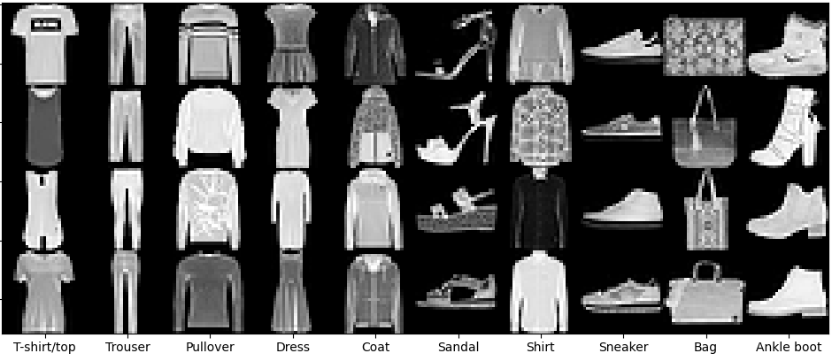
FashionMNSIT

Slide 26
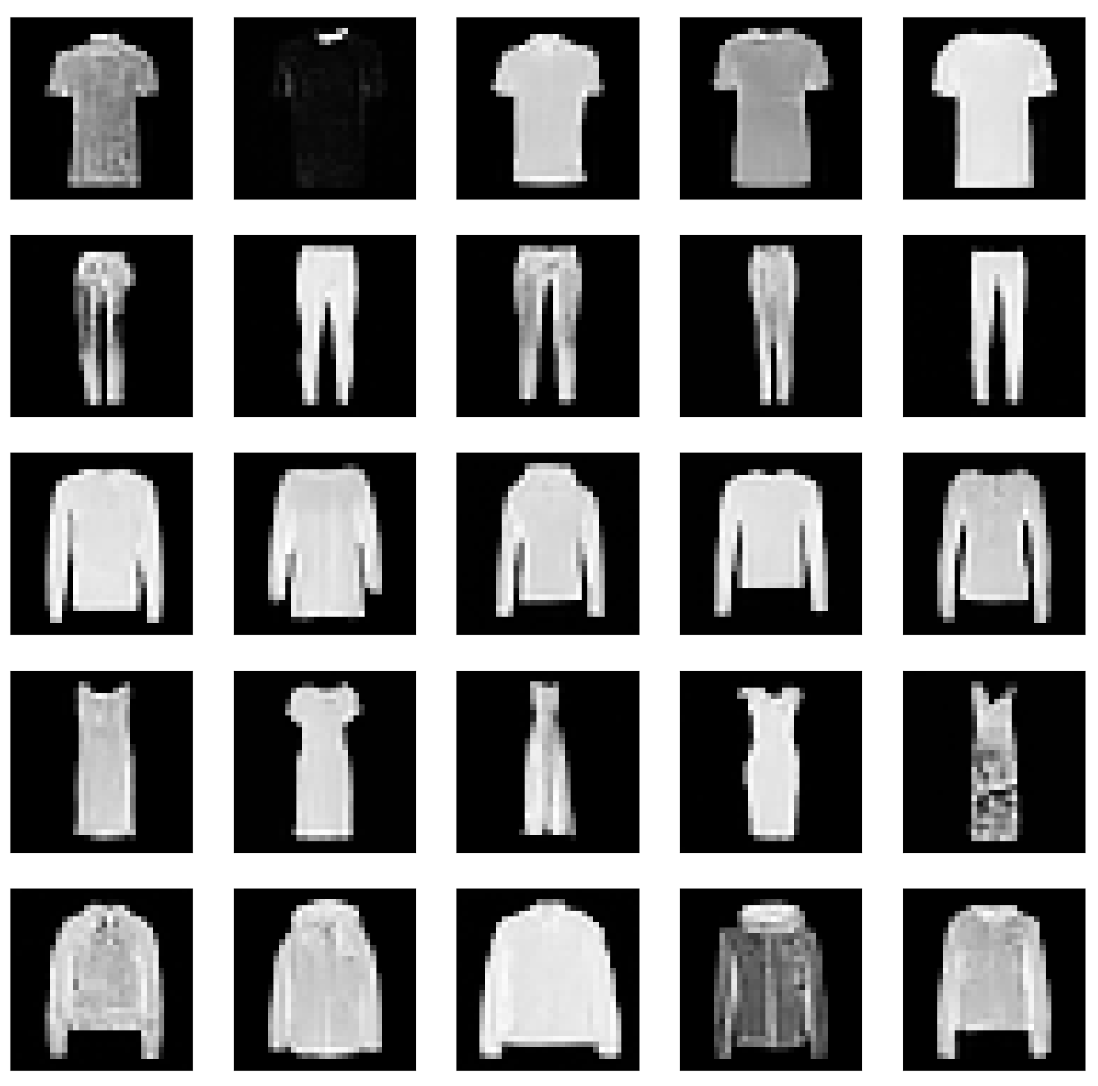
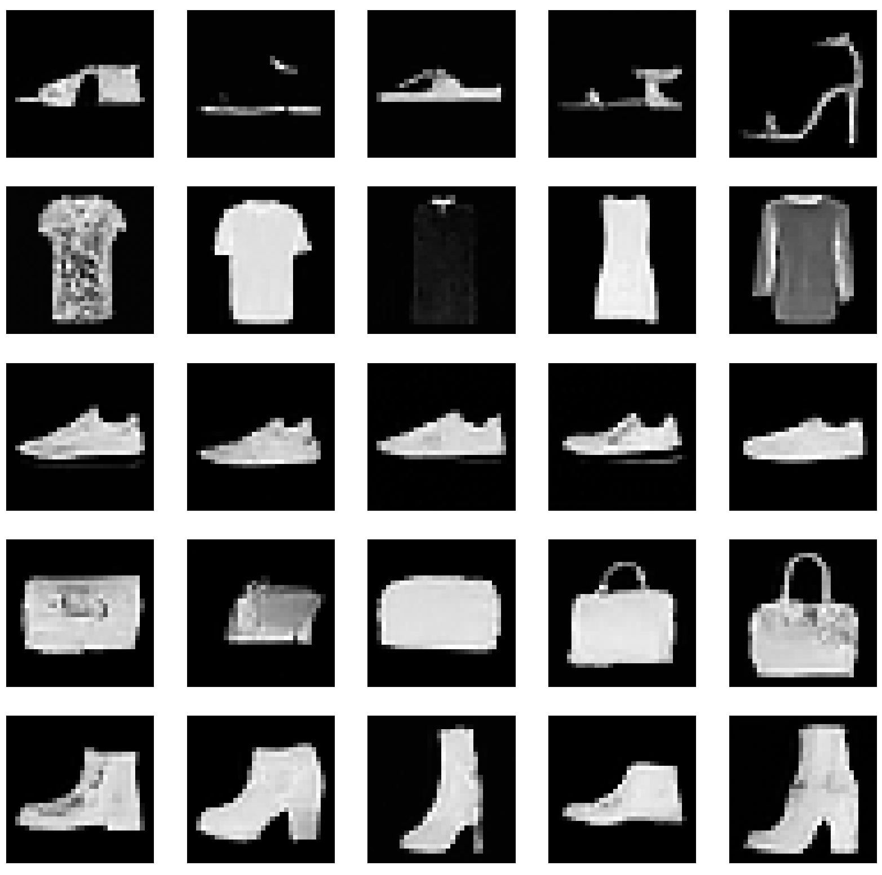
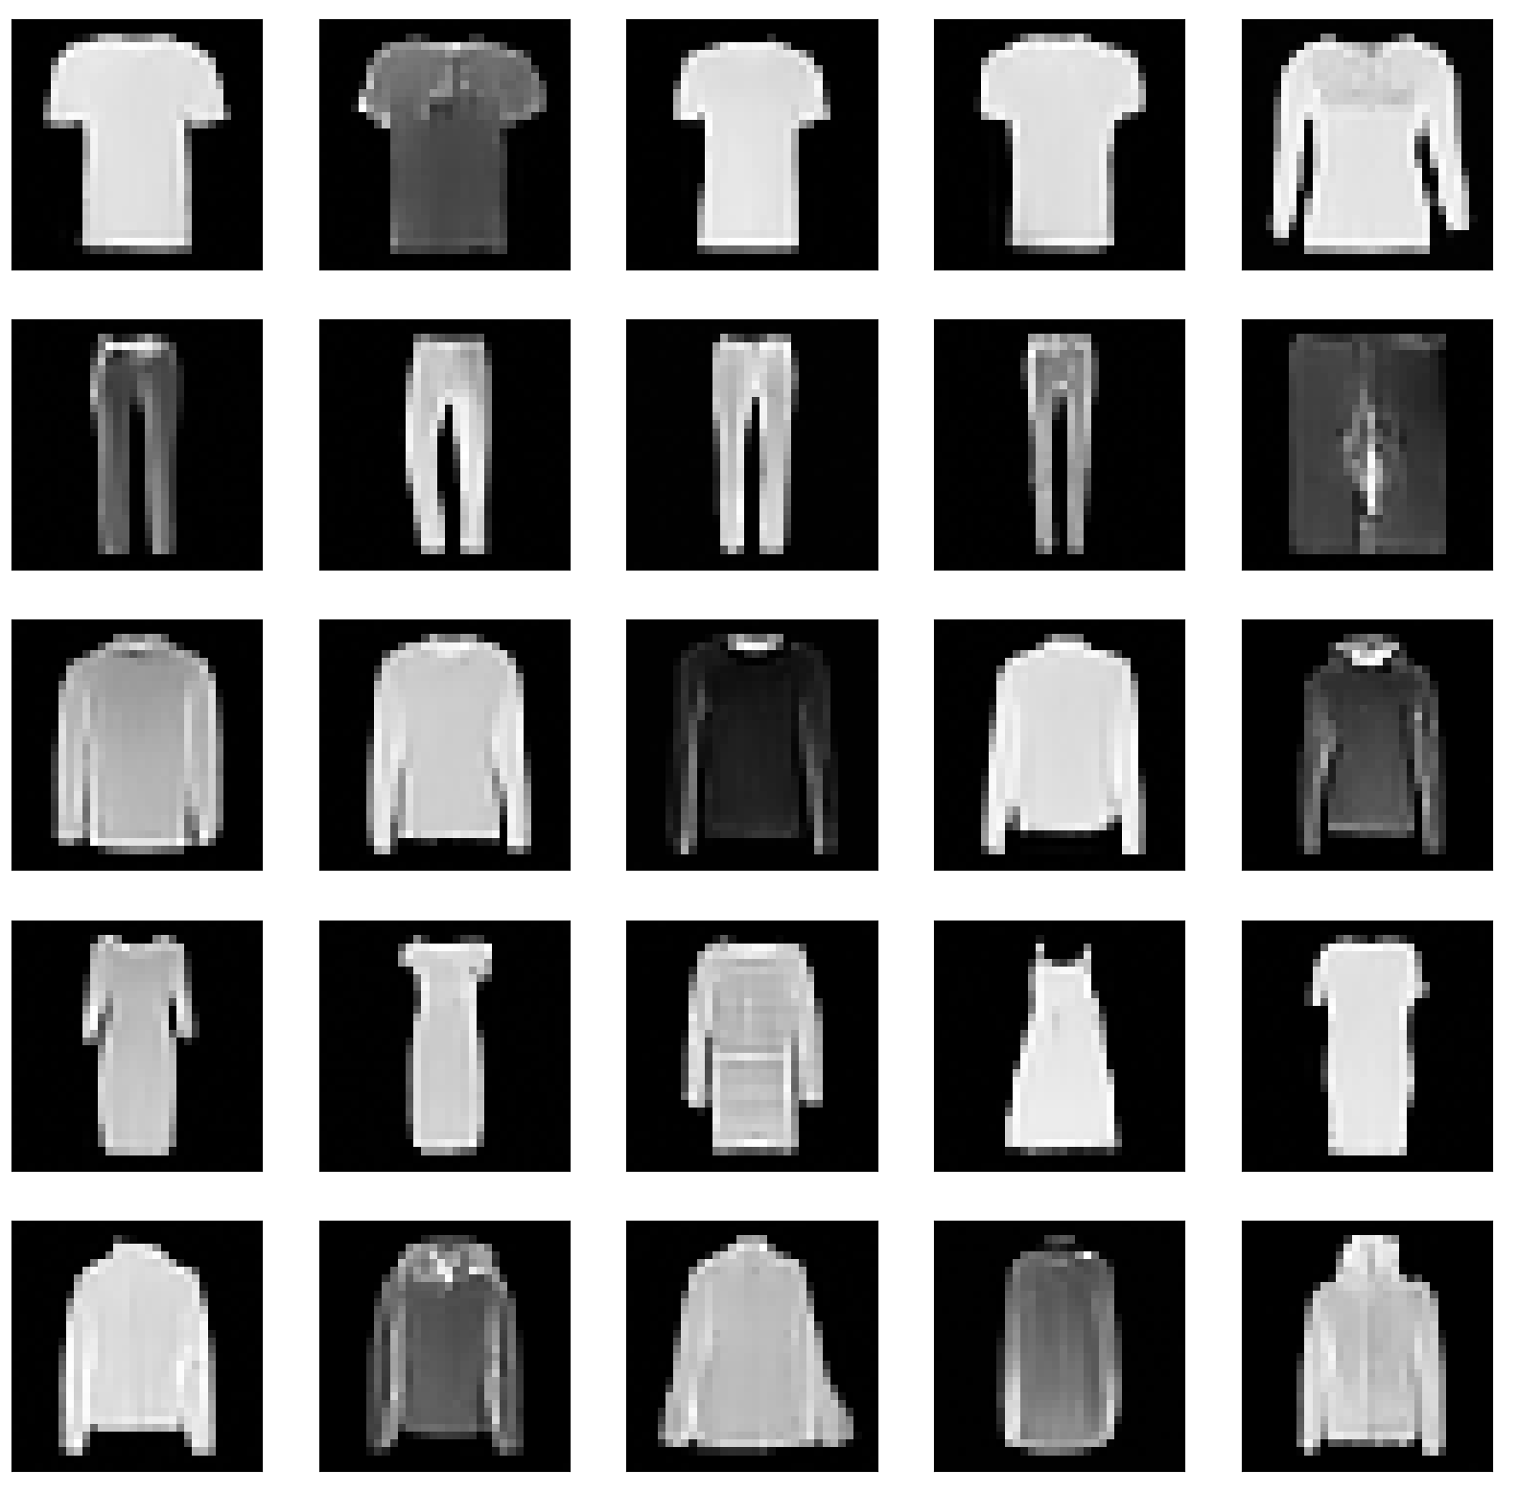
Expected Outputs (DDPM)

Slide 27
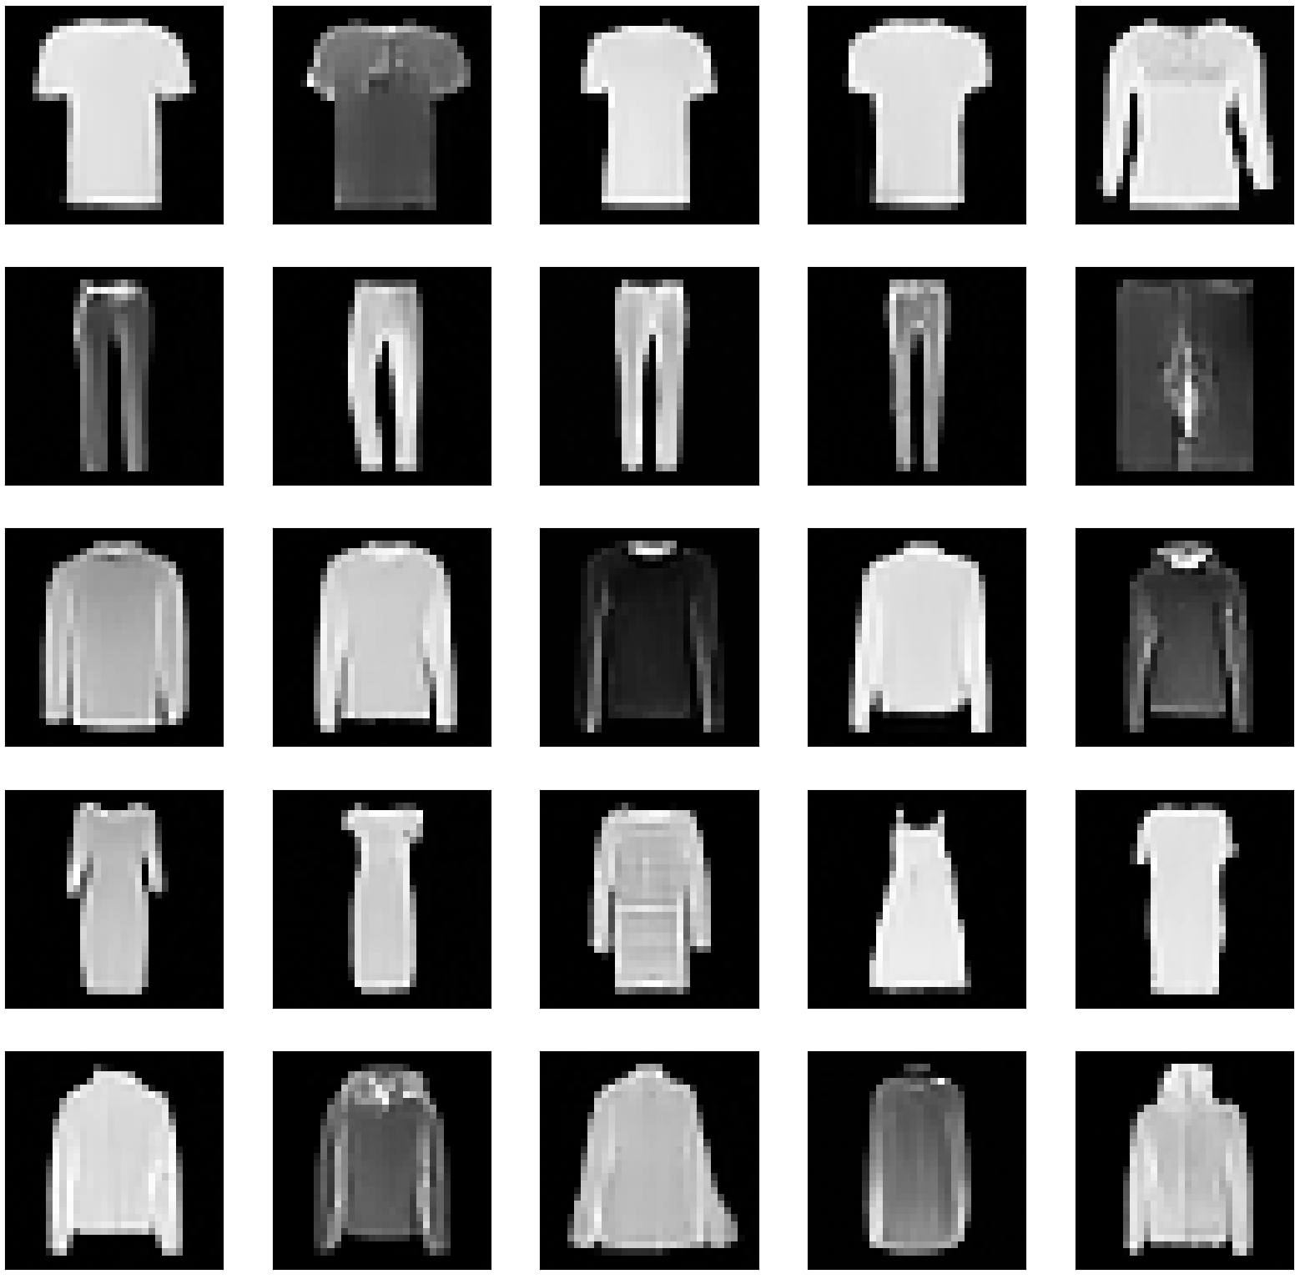
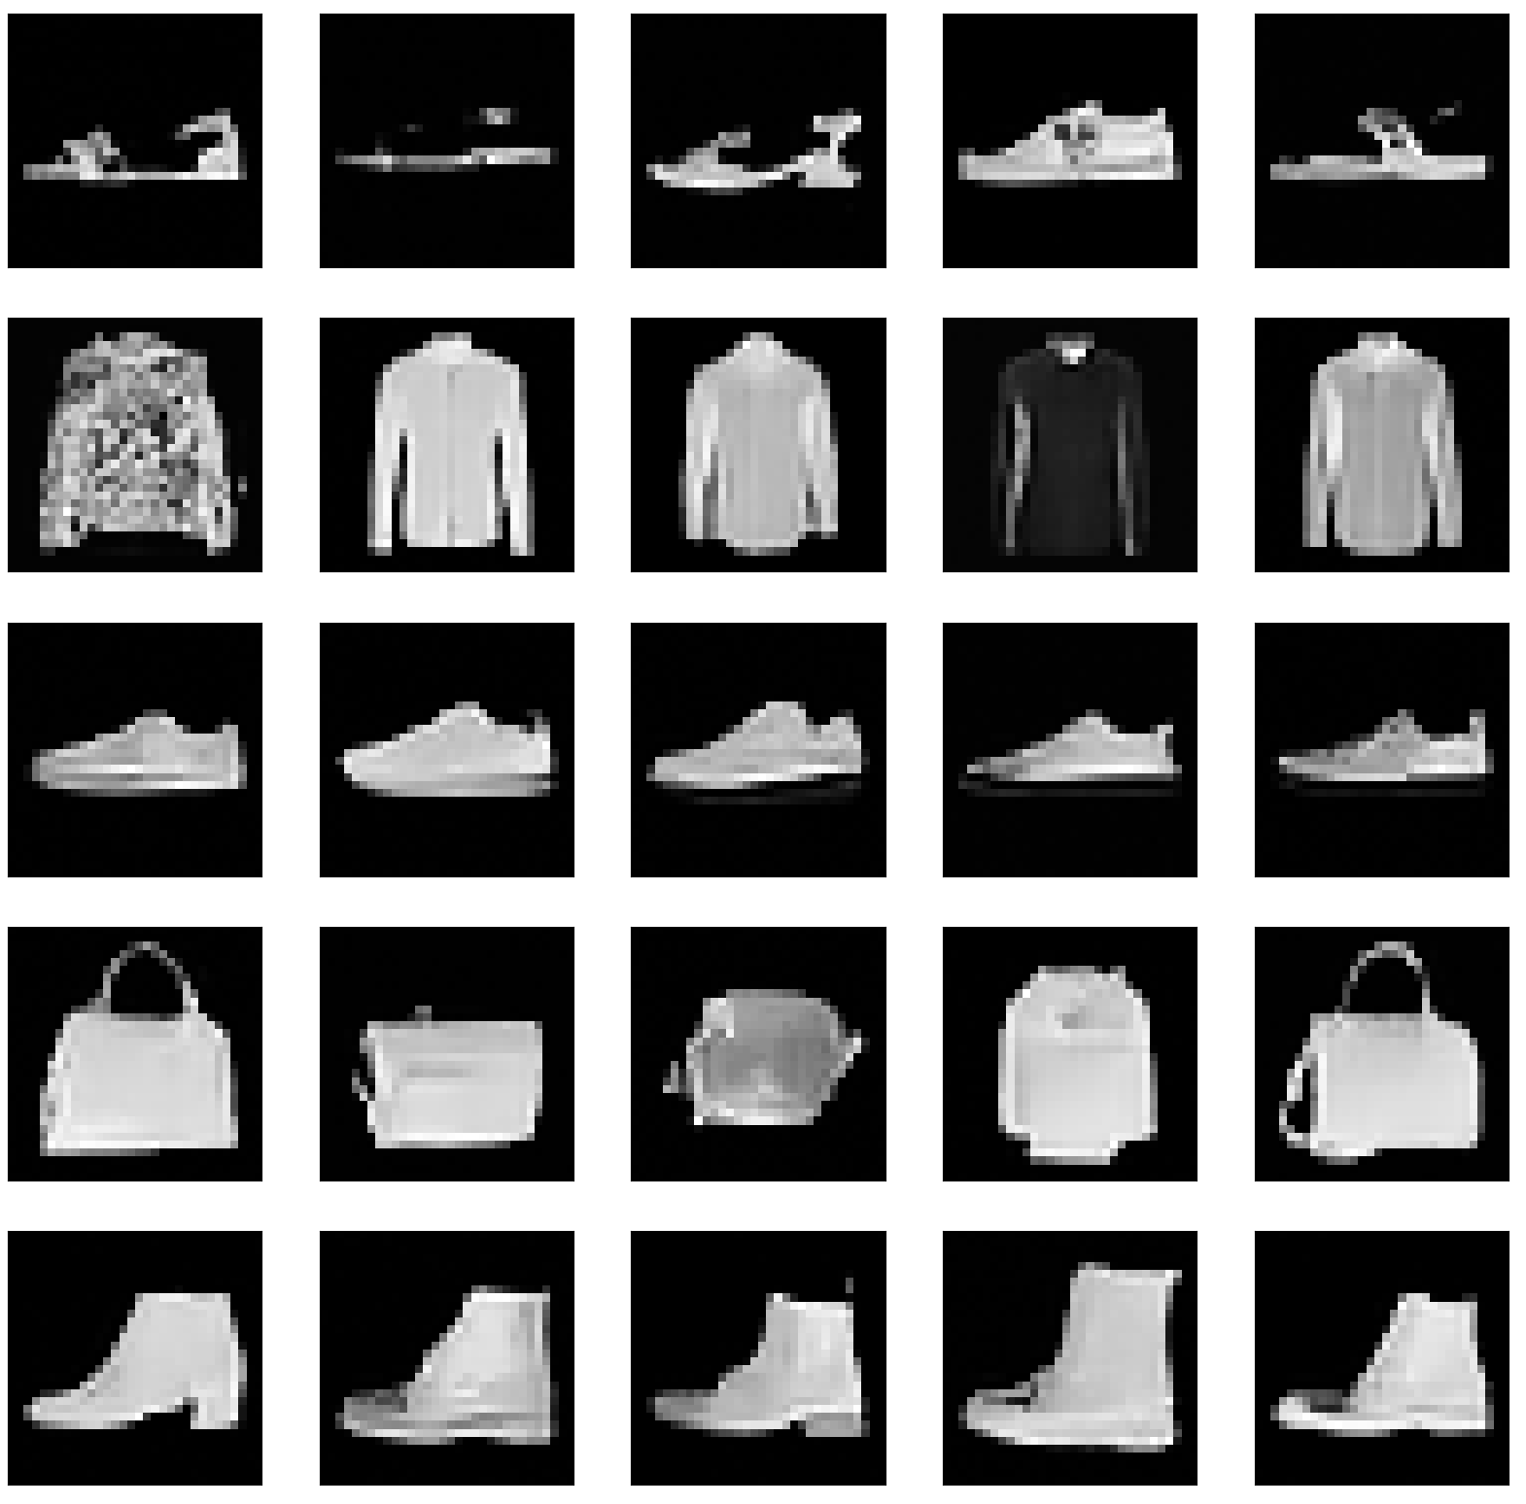
Expected Outputs (DDIM)

Slide 28
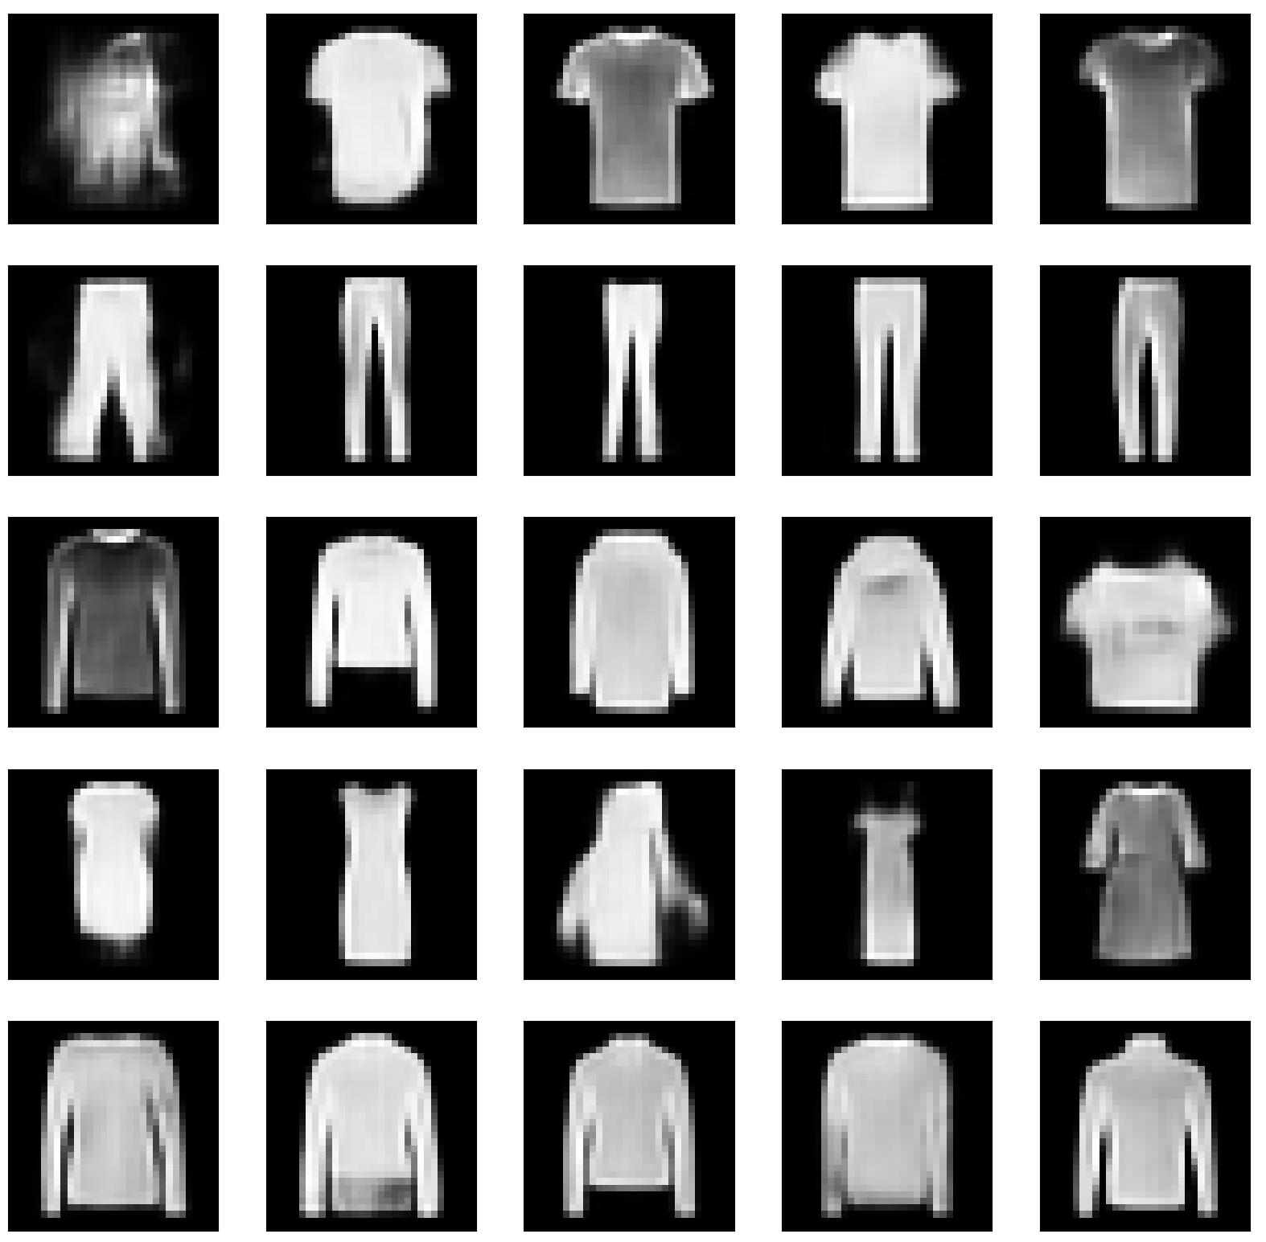
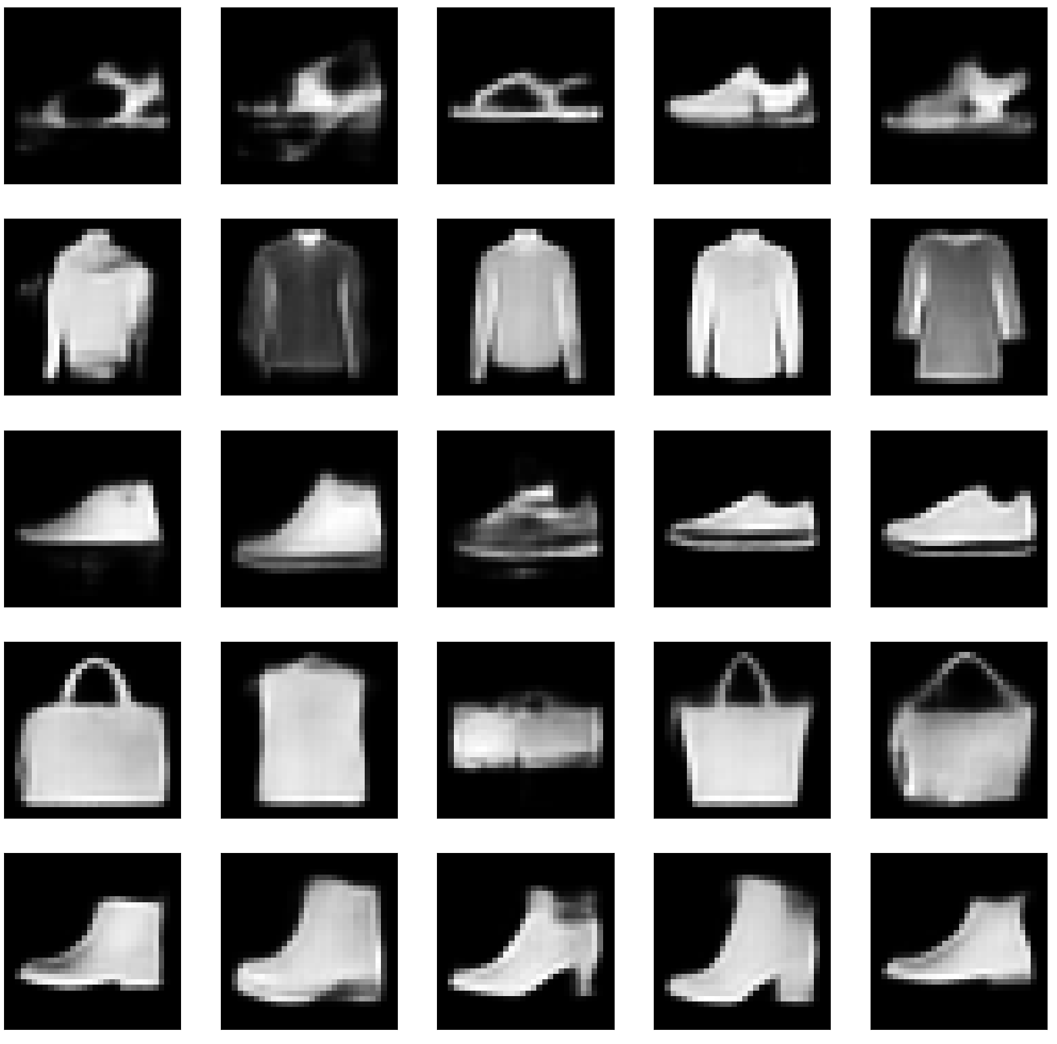
Expected Output (VAE)

Slide 29
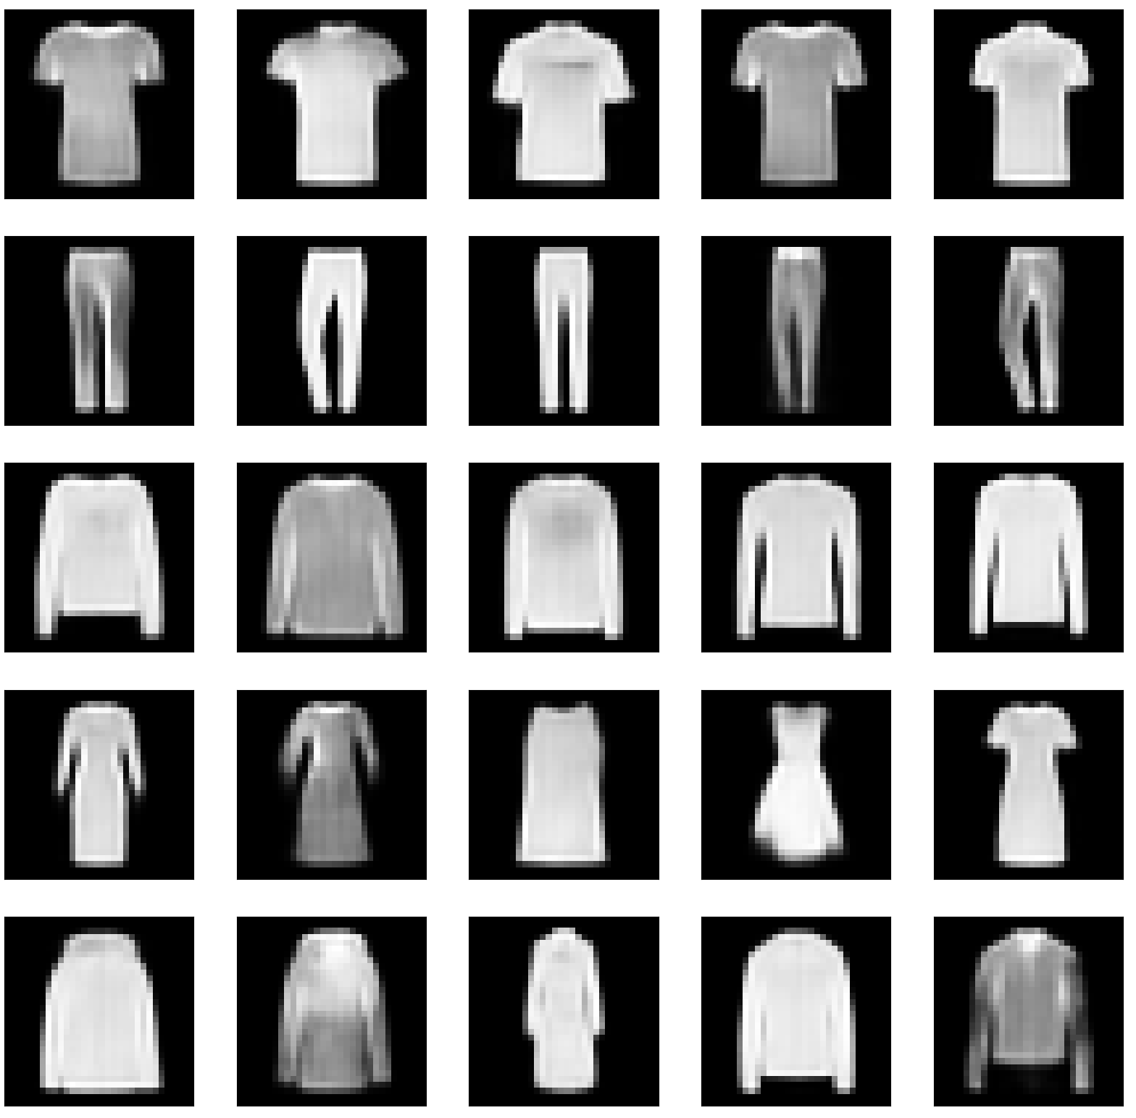
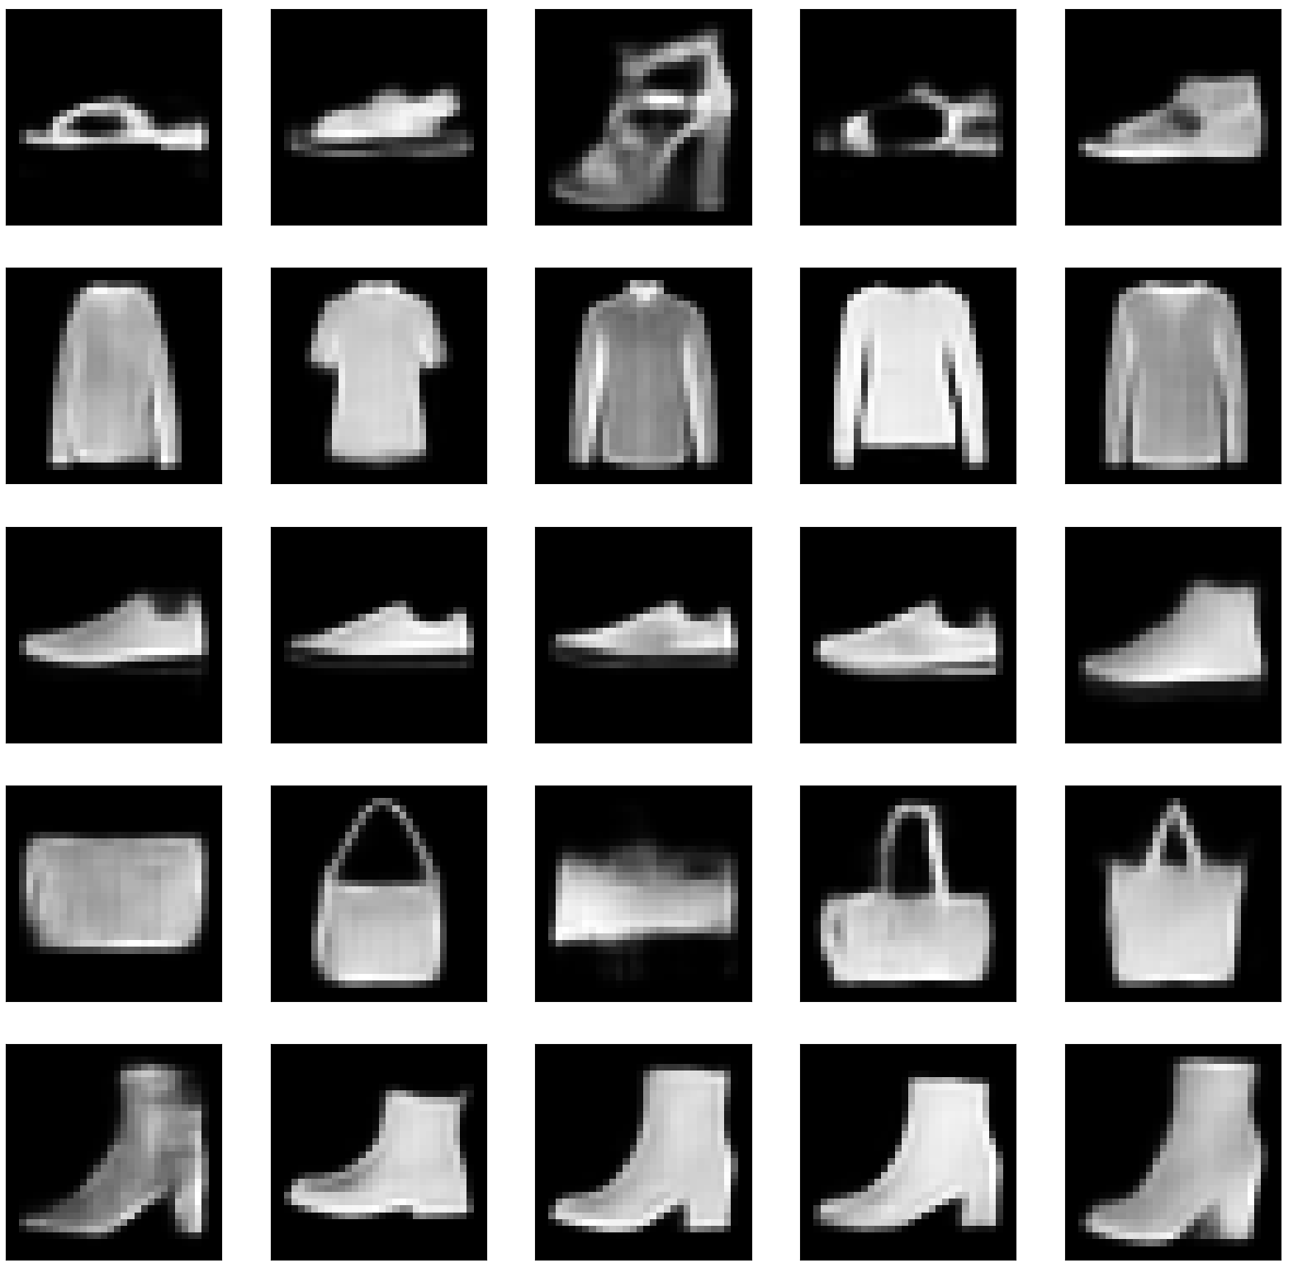
Expected Output (LDDPM)

